Slide 1
The Great Egg Defense
MDD 460 Capstone

Slide 2

Brandon Holland: Lead Design
Kyle Paetschow: Lead Programmer
Dom Pajak: Lead Animator

Slide 3
Backstory
Cavemen stole dinosaur eggs
Dinosaurs attack the village

Slide 4
Genre: Real Time Strategy
Sub Genre: Tower Defense
Platform: Desktop web browser
Premise: Cavemen build towers to fend off meat eating carnivores trying to retrieve their stolen eggs.
Target Market: 15-25 years old

Slide 5
Player Motivation
Player wins when they have protected all the eggs
Eggs provide extra tower upgrades

Slide 6
Features

Slide 7
Features
Login
Ranking system
Upgrade tower shop
Multiple enemies
X2 Speed button
Ability to restart each level

Slide 8
Competitive Analyst
Dino Assault
Static tower placement
No cut scenes
4.99 after three levels
Waves are static
Better
No restrictions for tower placement
Coins carry over
No advertisements in game
Night level
Random waves
FREE

Slide 9
Team Charter
Budget
Time Commitments
$150.00 total
-$1.89 Sound Tracks
Kyle: 20 Hours/Week
Dom: 15 Hours/Week
Brandon: 15 Hours/Week
Online meetings three times a week

Slide 10
Design Elements

Slide 12
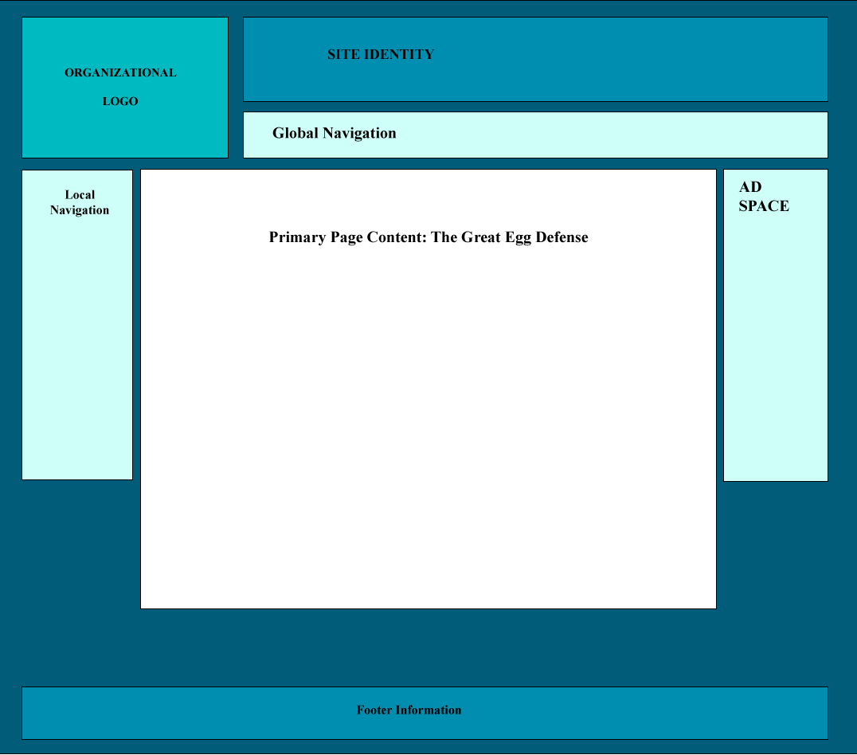

Slide 15
Assets
Art and Sound

Slide 16
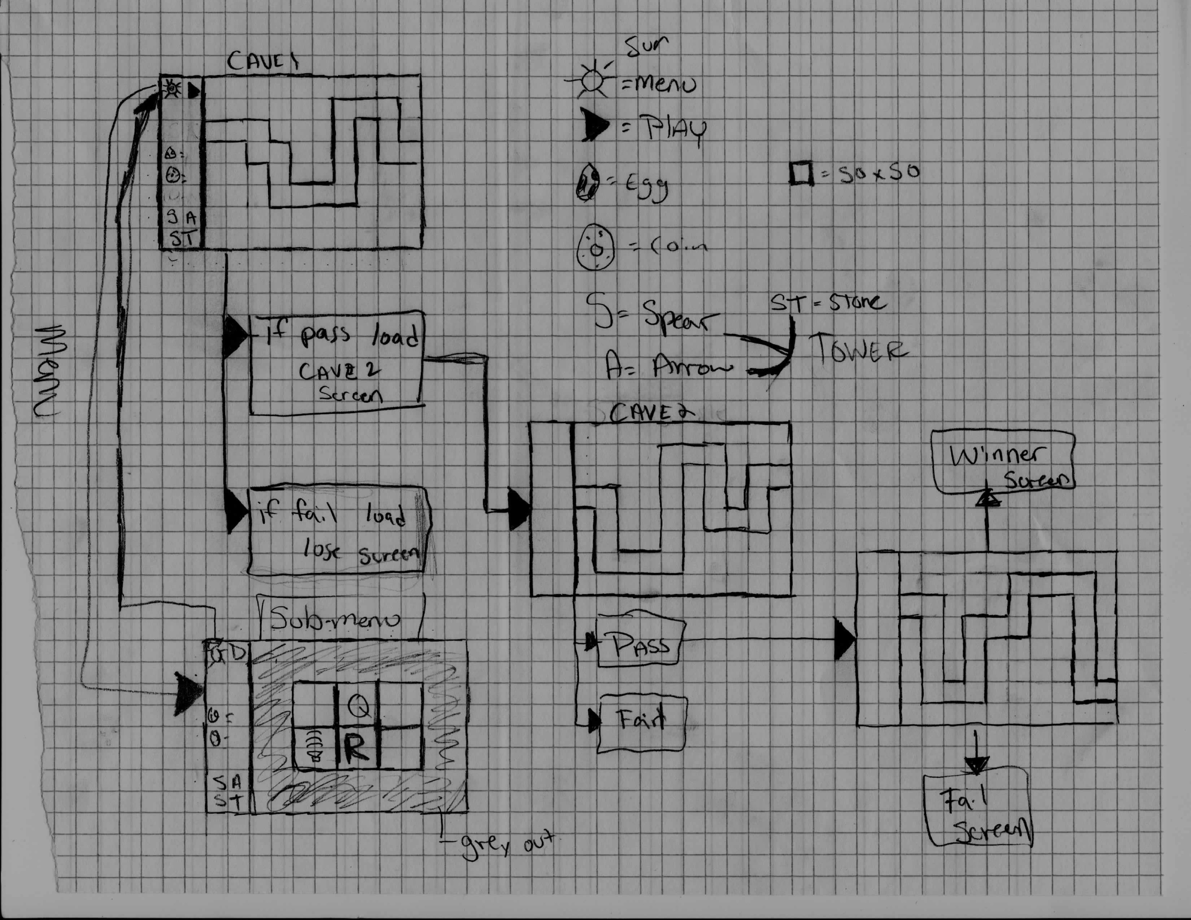
Map

Slide 17
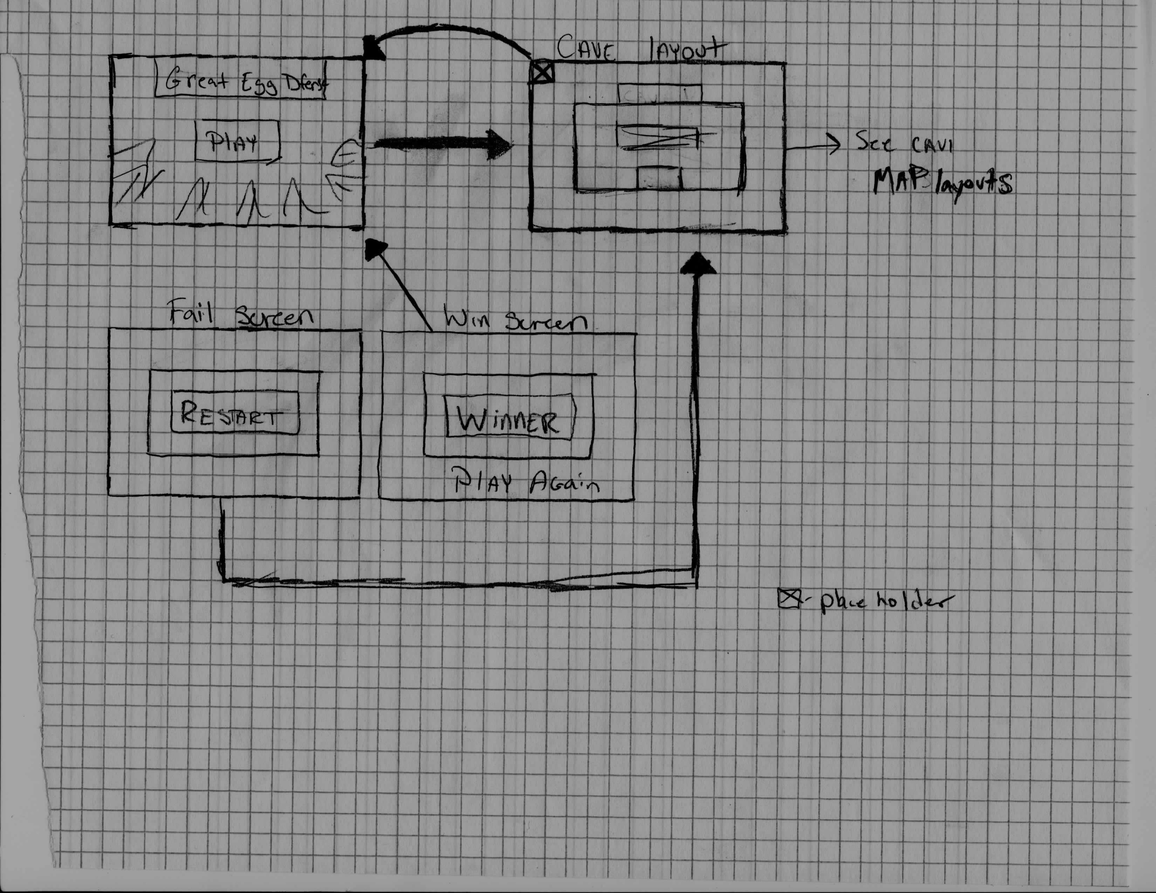
Map

Slide 18
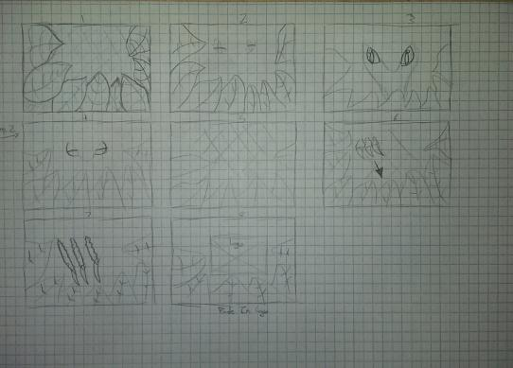
Story Board

Slide 19
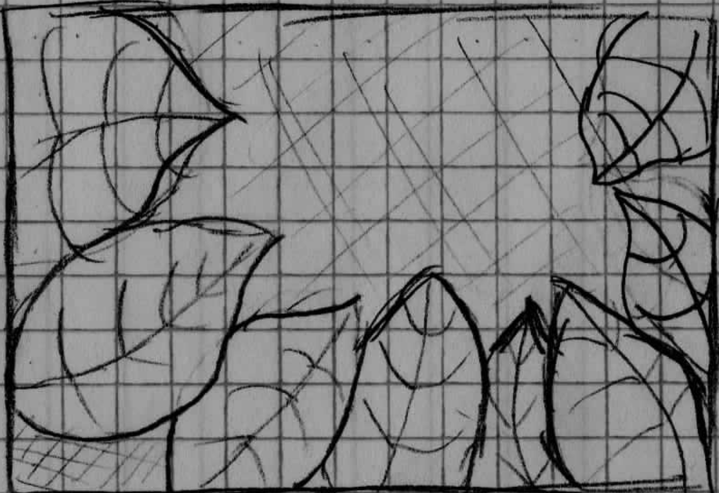
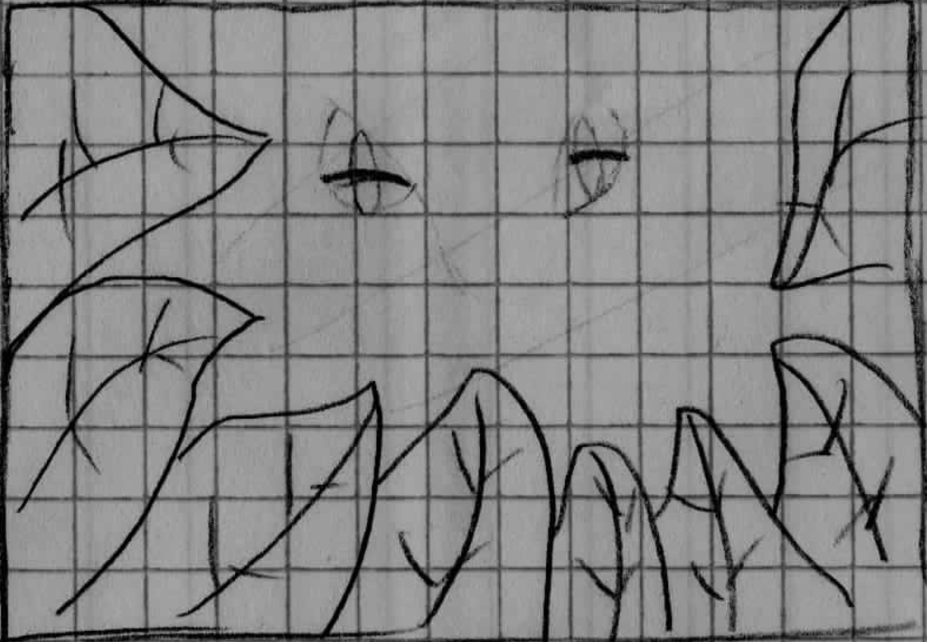

Slide 20
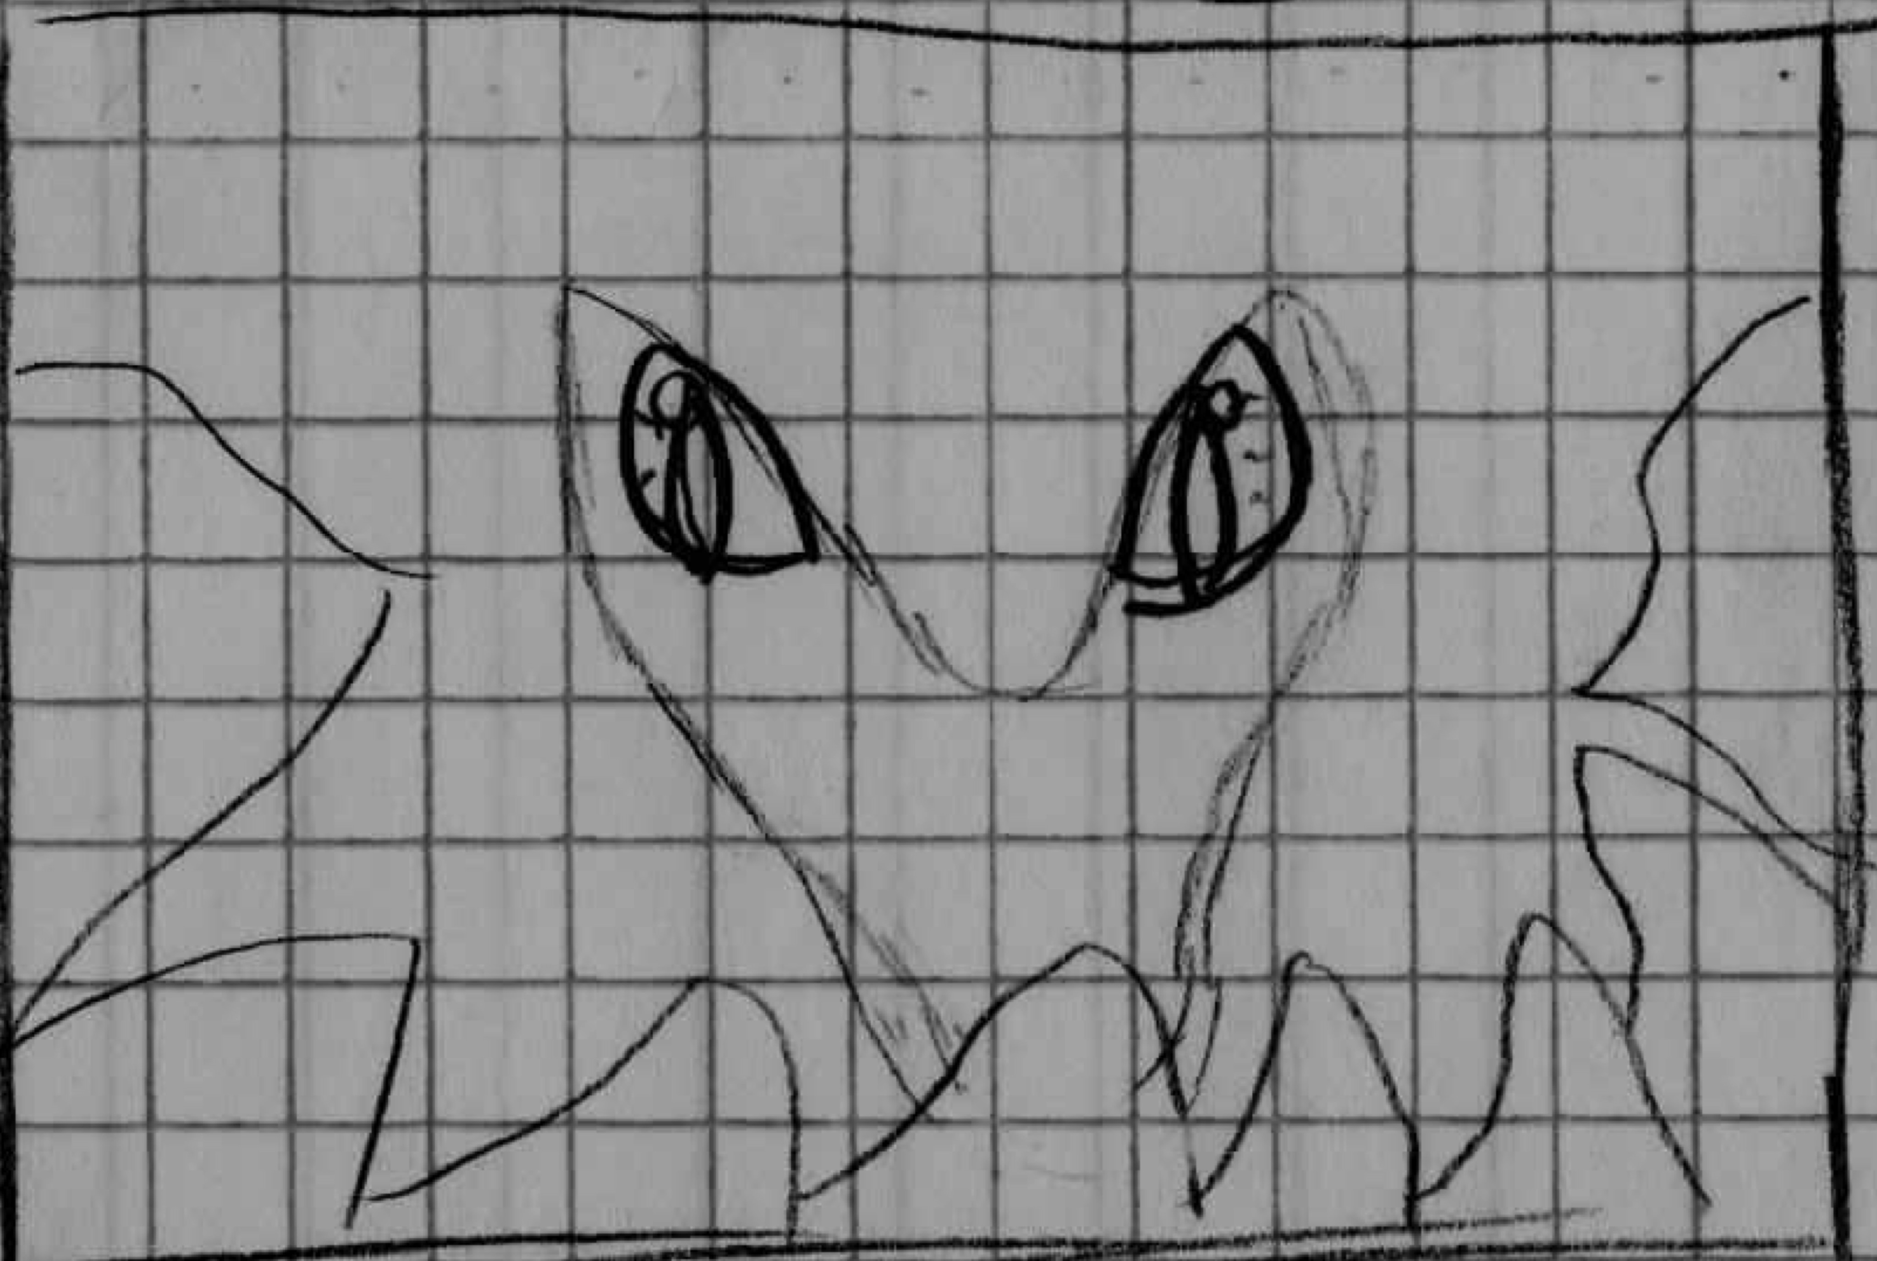
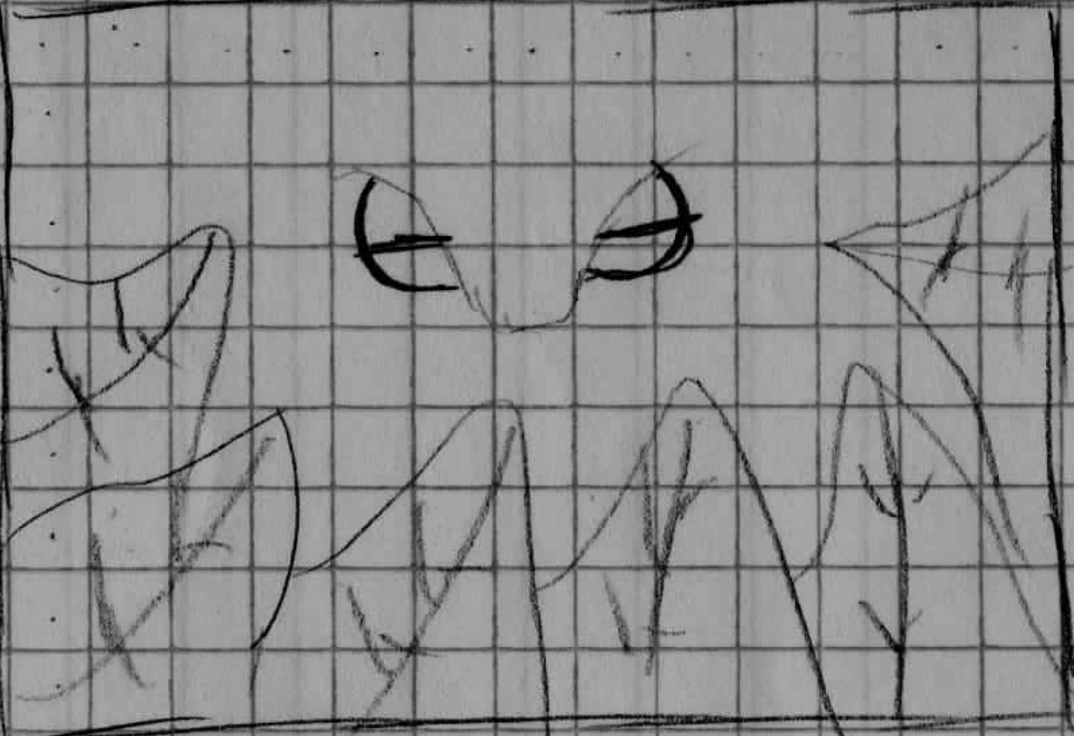

Slide 21
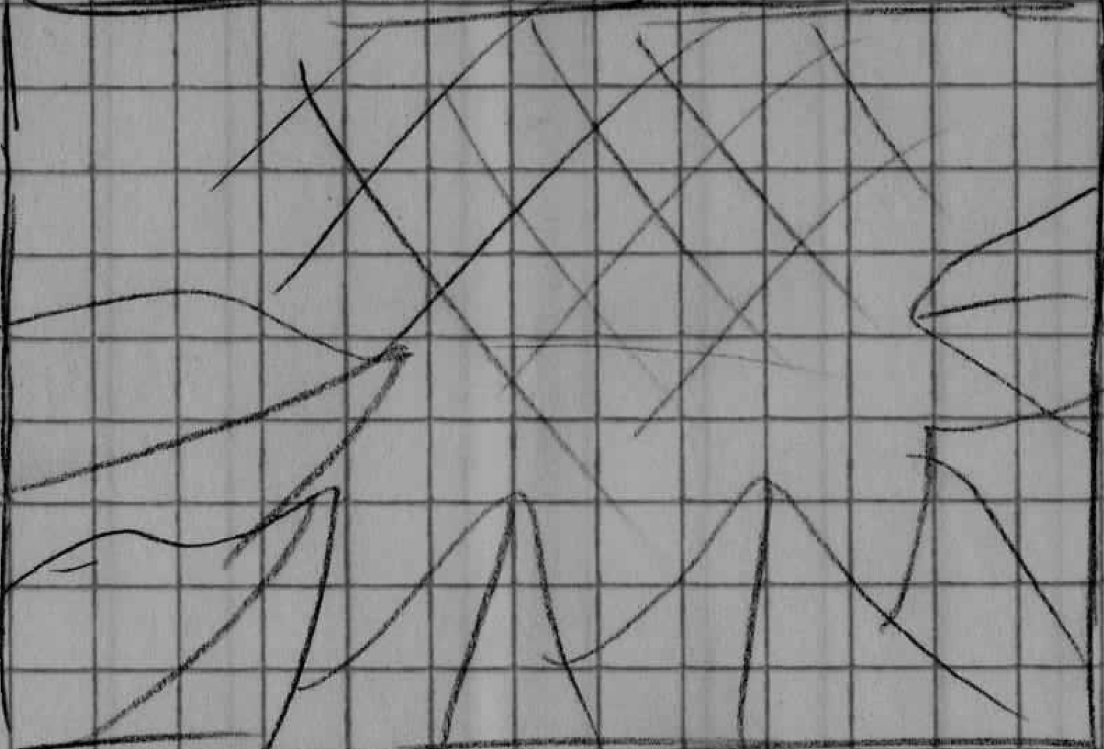
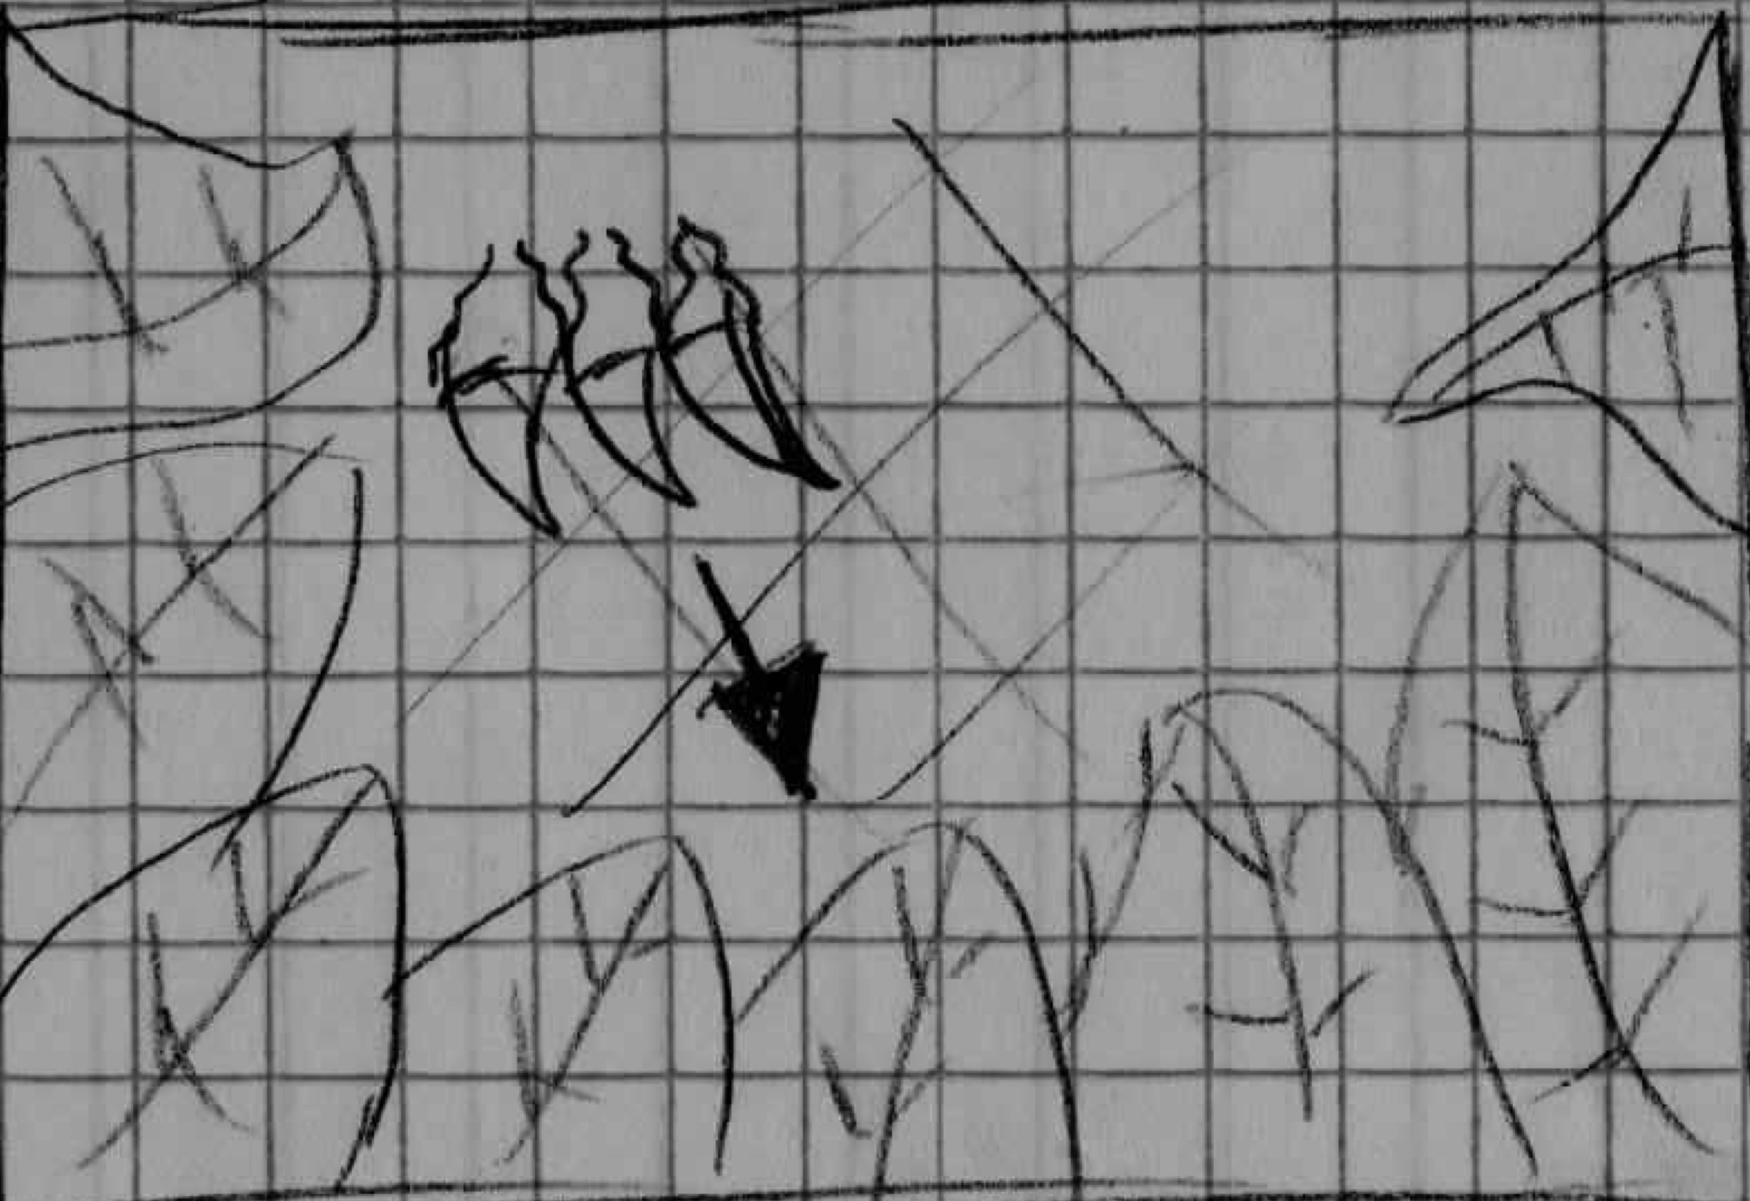

Slide 22
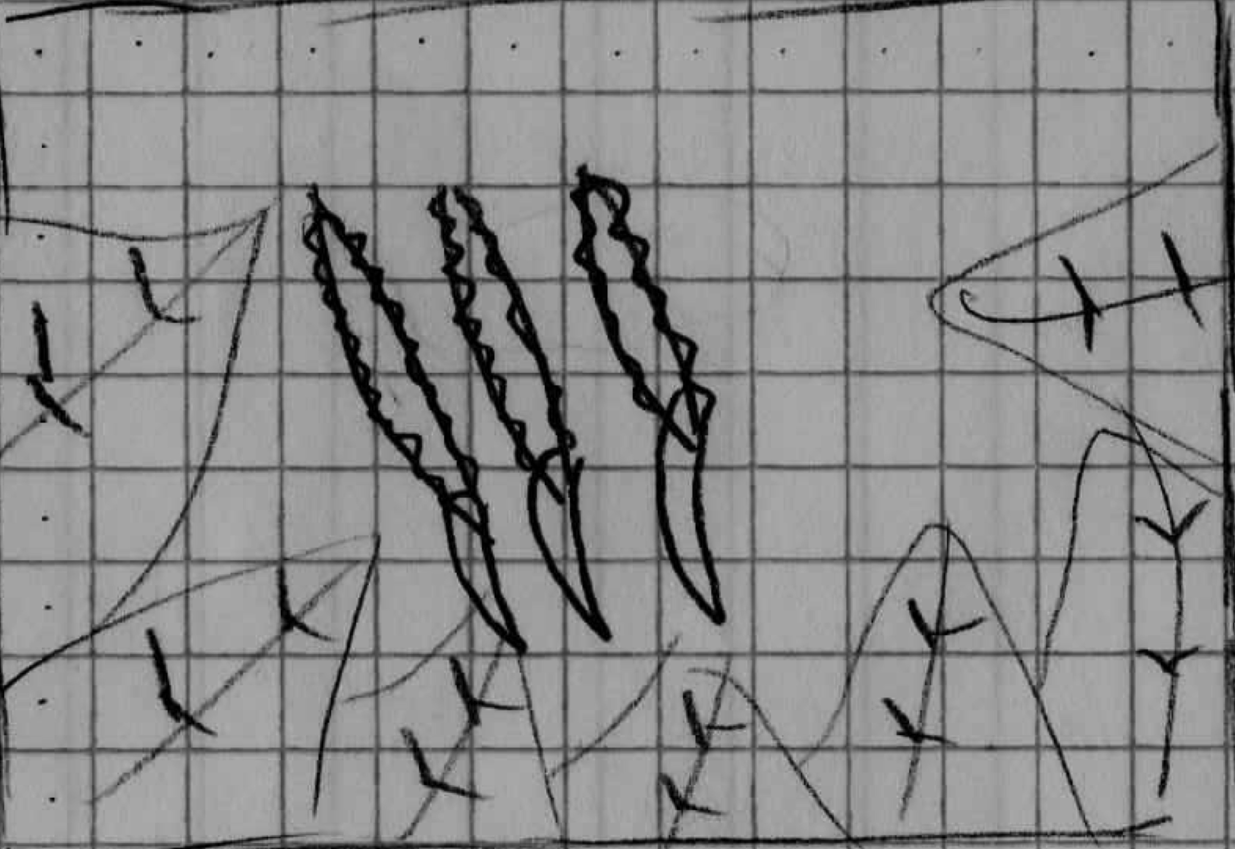
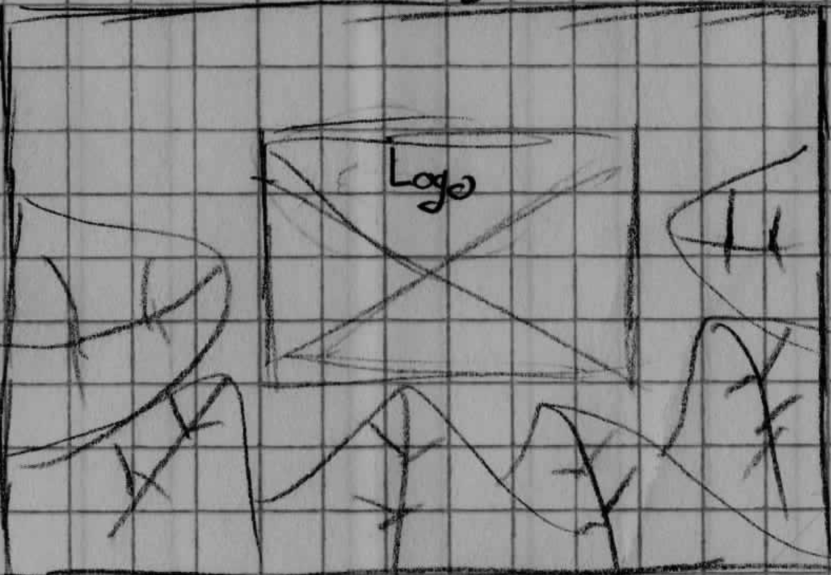

Slide 23
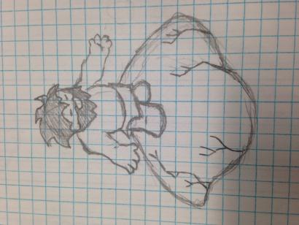
Towers

Slide 24
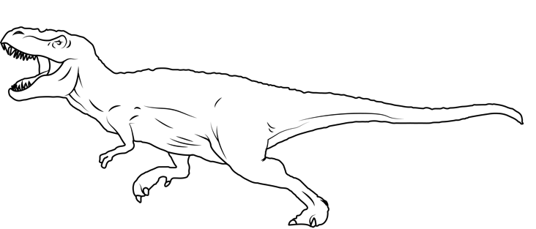
T-Rex

Slide 25
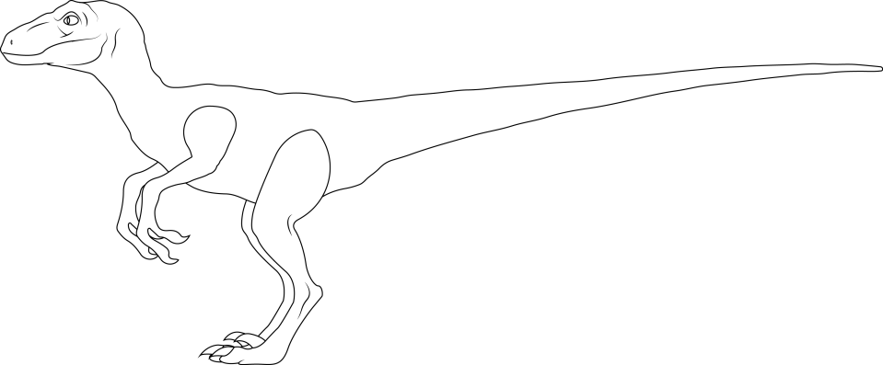
Raptor

Slide 26
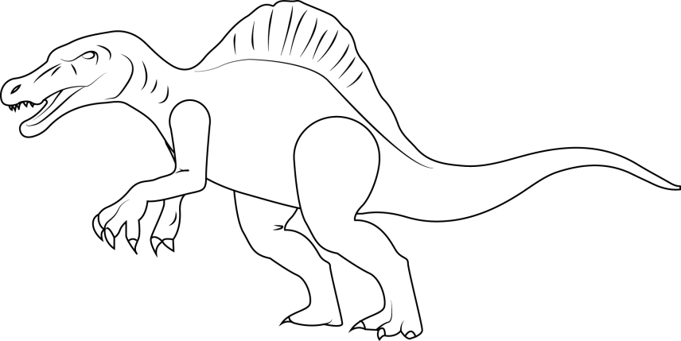
Spinosaurus

Slide 27

Weapons

Slide 28


Sample Sounds
Background Clip
Growl

Slide 29
Gantt Chart

Slide 31
What we learned

Slide 32
Project management
Sound editing
UML and Data Flow Charts

Slide 33
Questions?

